Slide 1



RIBY DASHBOARD
CELESTINE ADOM TETTEH
View in Power BI

Slide 2
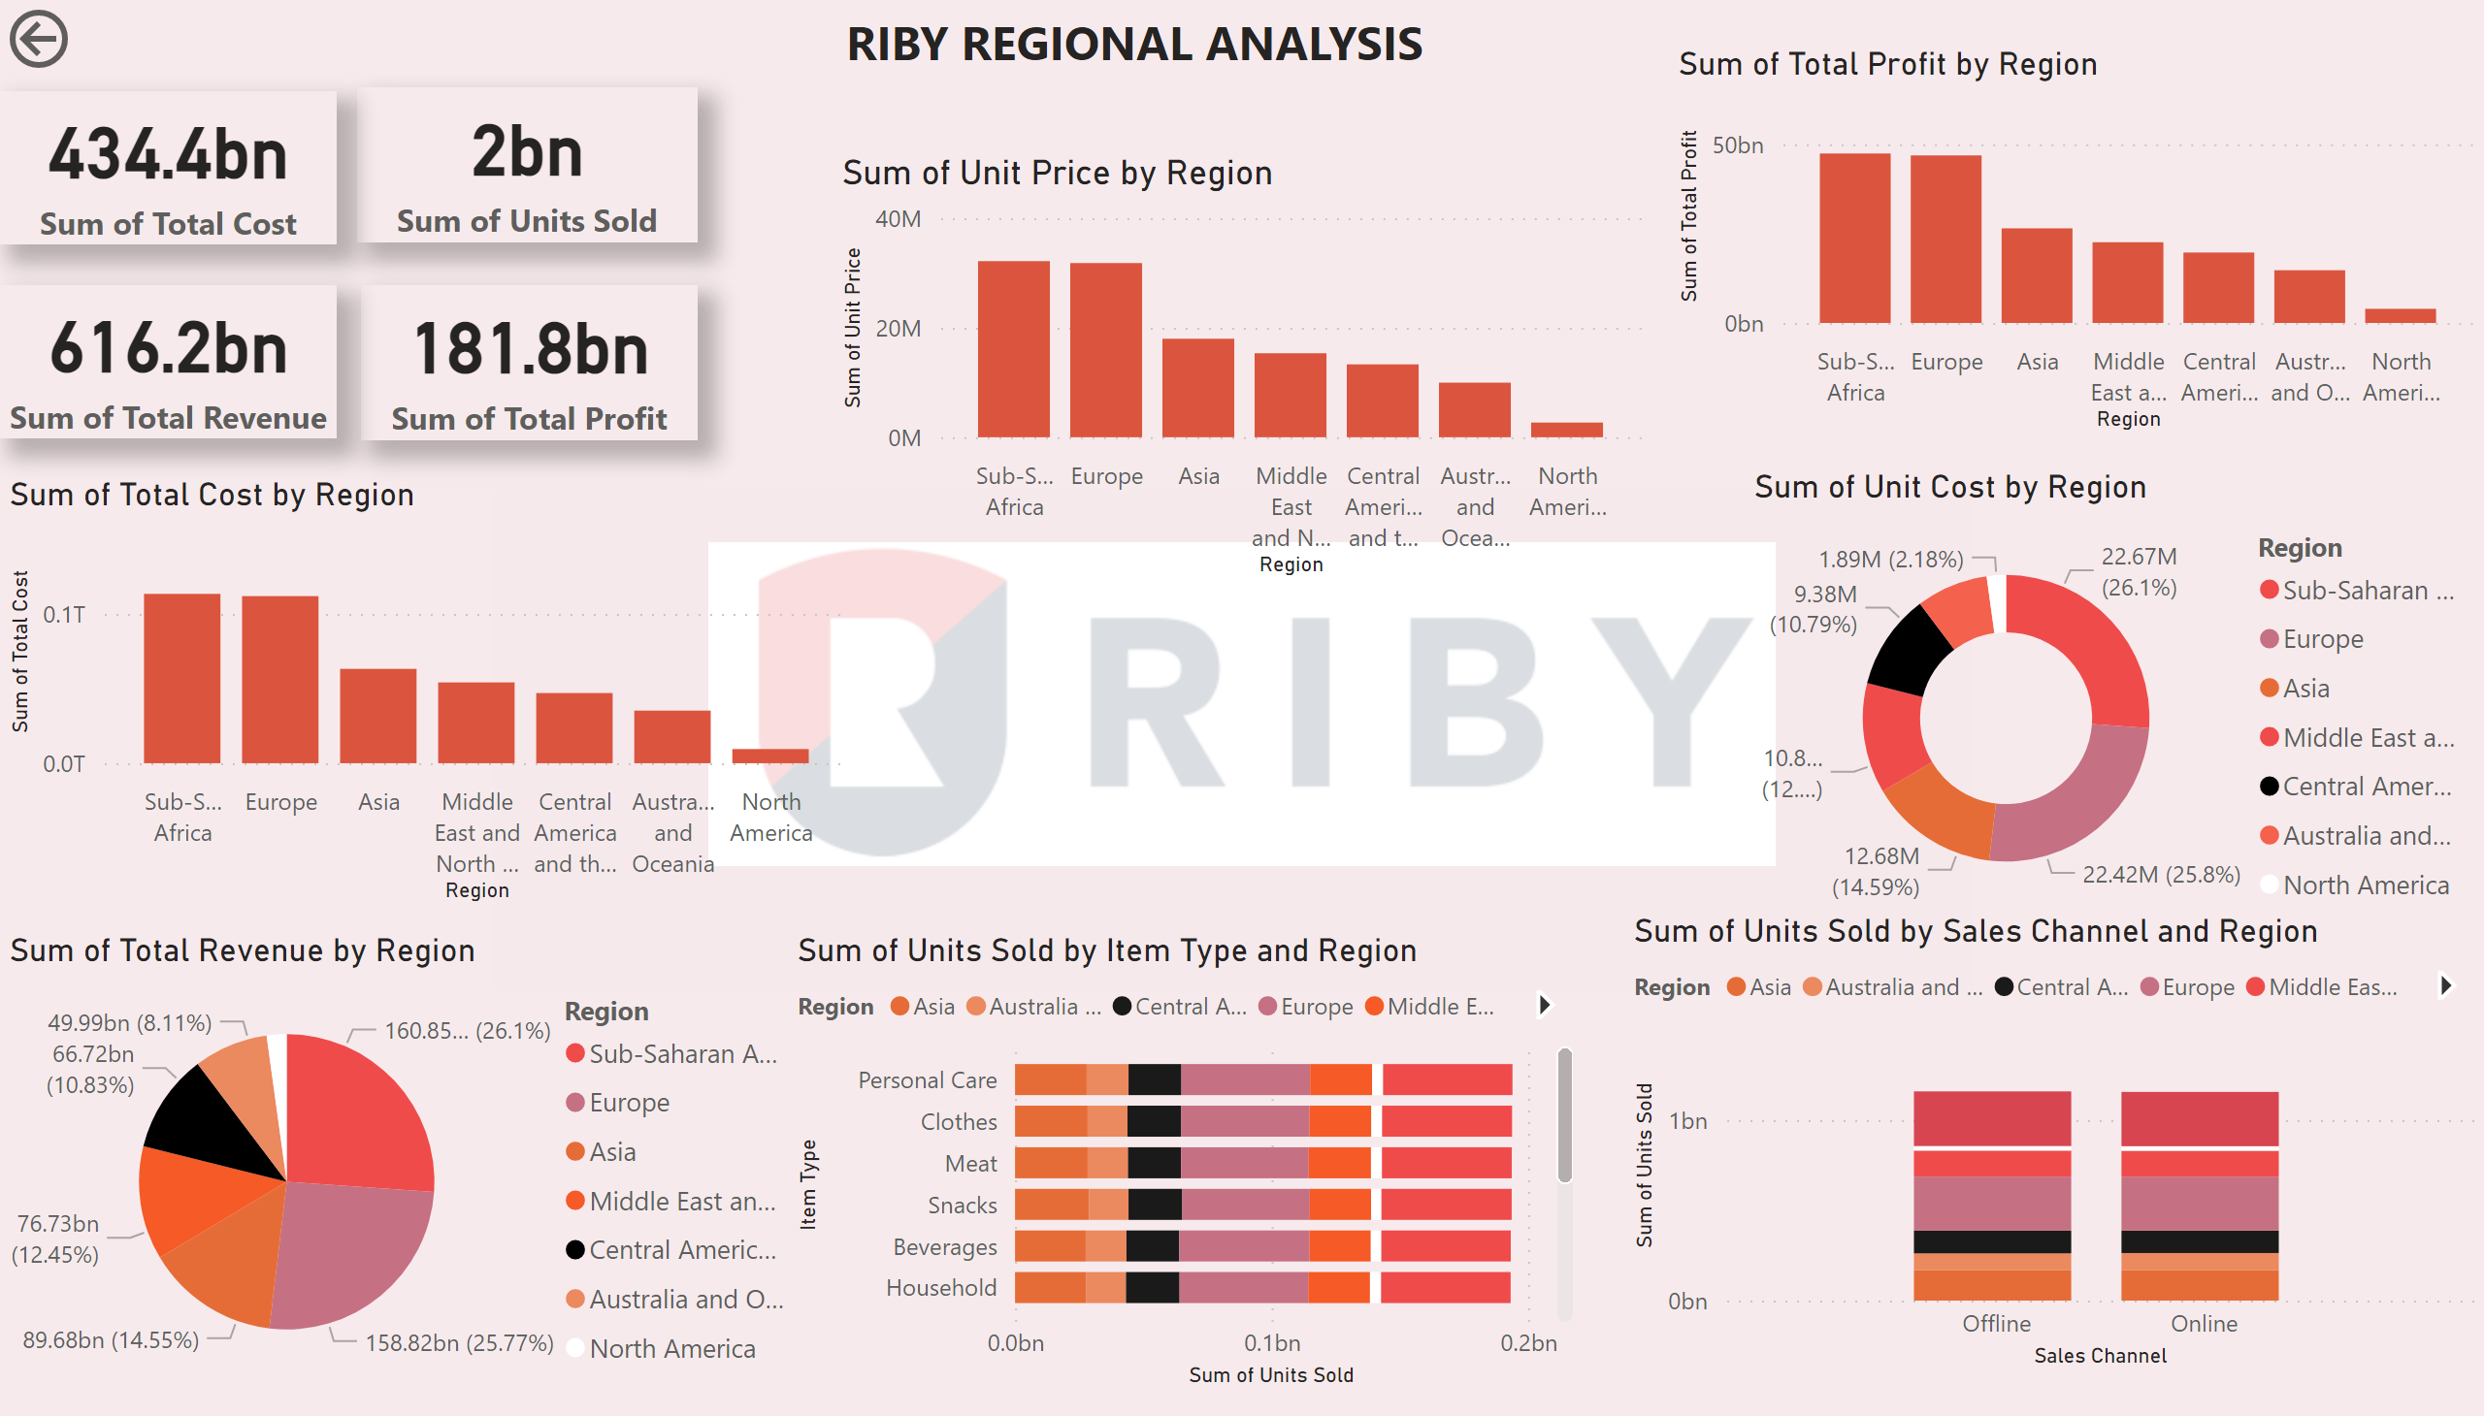
Page 1
Notes:
columnChart
No alt text provided
pieChart
No alt text provided
columnChart
No alt text provided
barChart
No alt text provided
donutChart
No alt text provided
columnChart
No alt text provided
columnChart
No alt text provided
textbox
No alt text provided
card
No alt text provided
card
No alt text provided
card
No alt text provided
card
No alt text provided
actionButton
No alt text provided

Slide 3
Riby can decide to prioritize its investment in the various regions using the following:
﻿Top 5 regions in terms of profit were Sub-Sahara, Europe, Asia, Middle East and North Africa and Central America and the Caribbean.
These top 5 regions gave the highest revenues
Preferences should be given to item type sold in each region
Items like Cereals, fruits, etc gives much revenue in Europe than the Sub-Sahara region though aggregately, the latter recorded the highest revenue.

